Slide 1
MACOM Diode Products - Schottky rev 0
Joe Bukowski, Rick Cory
3 March 2017

Slide 2
PRODUCT FAMILIES
PIN/NIP Diodes:
Switching
Attenuation
Limiting
Varactor Diodes:
Tuning
Phase Shifting
Schottky Diodes:
Detection
Frequency Mixing
Diode Products
Attenuators
Multiplier Diodes:
Frequency Multiplication
Waveshaping
Passive Devices
RF Chokes/Inductors
MNS Capacitors
Resistors

Slide 3
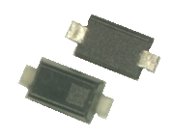




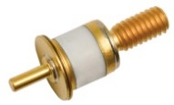



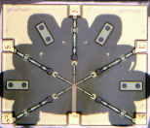
PRODUCT CONFIGURATIONS
Plastic
(to 6 GHz)
HMIC Discrete Surmount
(to 26.5GHz)
Bare Die
(to 18 GHz)
Discrete Device
Beam Lead/ Flip Chip
(to 70+ GHz)
Hermetic Packaged
(to 12 GHz)
Si HMIC
(to 26+ GHz)

Slide 4
Schottky Diodes
Schottky diodes are RF/microwave rectifier or switching elements
Schottky diodes are formed by a metal-semiconductor junction
MACOM Schottky diodes are made from Si or GaAs

Slide 5

Walter Schottky
Swiss/German Physicist, 1886 – 1976
Studied thermionic emission and surface effects in metals and semiconductors
Studied under Max Planck at the University of Humboldt, awarded PhD in physics 1912,
Invented the screen-grid vacuum tube
Taught at the University of Wurzburg and the University of Rostock
Worked at Siemens Research Labs, 1914 – 1919 and 1927 - 1958
Source: https://en.wikipedia.org/wiki/Walter_H._Schottky

Slide 6
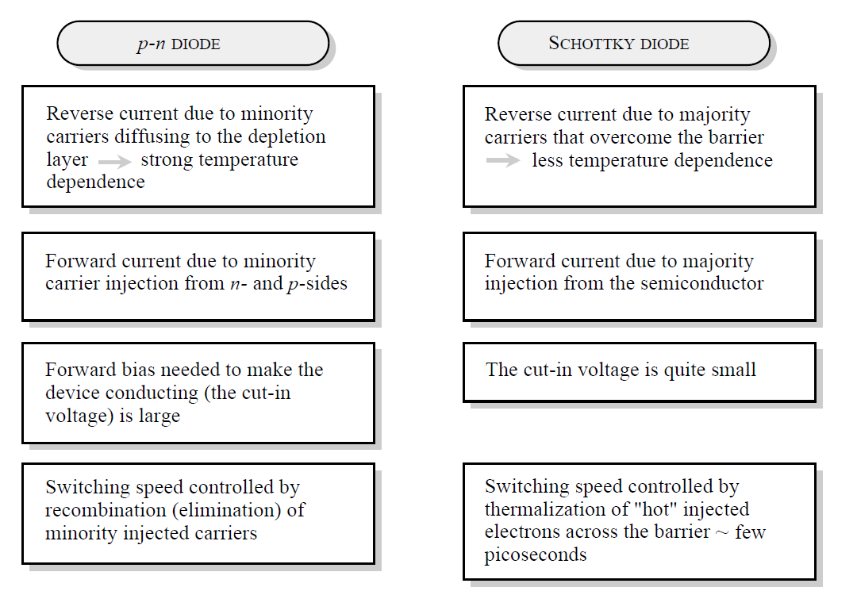
P-N Junction vs. Schottky Junction
Source: Singh, J., Semiconductor Devices: Basic Principles, Chapter 7, Wiley, 2001

Slide 7
Schottky Diodes
Metal layer has excess electrons
Semiconductor layer
N type layer is the cathode
P type (Si only) is anode
metal
junction
n or p semiconductor

Slide 8
Schottky Diodes
The energy required to move an electron in the semiconductor from the valence band to the conduction band is less than the energy required to move an electron out of the metal
Rectifying junction is formed
eψ_{M}
eχ
eψ_{S}
Electron
Energy
eφ_{B}
eφ_{SM}
W₀
W_{V}
Junction
metal
semiconductor

Slide 9
Schottky Diodes
The amount of energy required to cause conduction is determined by the metal-semiconductor combination and is referred to as the barrier height
The forward voltage for a given bias current is proportional to the barrier height

Slide 10
Metal-Semiconductor Barrier Heights

Slide 11
Schottky Diode Barrier Heights
Si Schottky Diodes
Four barrier heights available
High barrier
V_{f} at I_{f} = 1 mA ~ 0.6 V
Pt - Si
n-type substrate
Medium barrier
V_{f} at I_{f} = 1 mA ~ 0.33 V
NiC
n-type substrate
Low barrier
V_{f} at I_{f} = 1 mA ~ 0.25 V
Ti
n-type substrate
Si “Zero Bias Detector”
V_{f} at I_{f} = 1 mA ~ 0.2 V
Pd-Si,
p-type substrate
GaAs Schottky Diodes
Only one barrier height available
V_{f} at I_{f} = 1 mA ~ 0.7 V, Ti, n

Slide 12
Schottky Diode I-V Characteristic
For Forward Bias:

Slide 13
Typical Si Schottky I-V Curves
Typical forward bias curves are shown for
Si ZBD
Si low barrier
Si medium barrier
Si high barrier

Slide 14
Schottky Diodes
Schottky diode operation determined by majority carriers (electrons)
No minority carriers are temporarily stored in the depletion region,
Schottky diodes can switch impedance FAST !!!!!!
Fast switching permits rectification (detectors) and switching (frequency mixers) at RF/microwave frequencies

Slide 15
Schottky Diode Schematic
Substrate layer typically 100 μm thick
Epi layer typically << 1 μm thick
Structures are NOT drawn to scale
Depletion
region
Multilayer
Metal
Epi Layer
Passivation
Backside
Metal
Substrate

Slide 16
Schottky Diode Equivalent Circuit
Top Contact
Metal
Nitride
(Si₃N₄)
Thermal Oxide
(SiO₂)
R_{J}
C_{J}
C_{O}
Epitaxial
Layer
R_{S1}
Substrate
R_{S2}
Ohmic Contact
Backside Metal
Contact

Slide 17
Electrostatic Discharge
Schottky diodes are EXTREMELY sensitive to ESD
ESD Class 0 (HBM) devices
ESD damage often produces “walking wounded” junction
Performance deteriorates over time (hours, days or even months)
Immediate catastrophic failure occasionally occurs

Slide 18
Schottky Diode Configurations – Singles, Pairs
Single Junction
single ended mixers
Series Tee
balanced mixers
Reverse Series Tee
balanced mixers
Antiparallel Pair
subharmonic mixers

Slide 19
Schottky Diode Configurations - Quads
Ring Quad
Double balanced mixers
Crossover Ring Quad
Double balanced mixers
Same circuit as ring quad (above), but easier to build on a single-layer circuit board

Slide 20
Schottky Diode Configurations – Back-to-Back Crossover Ring Quads
Crossover Ring Quad
Used for higher-power double balanced mixers
Two ring quads connected (almost) in parallel

Slide 21
Schottky Diodes – Specifications of Interest
Capacitance - determined by circuit design
Forward voltage (barrier height) - determined by type of circuit (low power mixer, detector)
Configuration
single junction, series pair, etc.
Package Style
plastic, chip-on-board, multi-junction, etc.

Slide 22
Single-ended Mixer
Lowpass
Filter
RF Input
IF Output
RF Choke
LO Input
Very simple design
Includes single Schottky diode
Poor inter-port isolation

Slide 23
Balanced Mixer
RF Choke
RF Input
Lowpass
Filter
IF Output
LO Input
3 dB Hybrid
RF Choke
Includes matched pair of Schottky diodes
Better inter-port isolation

Slide 24
Subharmonic Mixer
RF Input
RF Input
RF Filter
RF Filter
IF Filter
IF Filter
IF Output
IF Output
LO Filter
LO Input
Actual LO Frequency is Subharmonic of Effective LO Frequency
Schottky diodes multiply input LO frequency AND multiply incoming RF signal by multiples (harmonics) of input LO frequencies
Poor inter-port isolation

Slide 25
Double Balanced Mixer
LO
Input
RF
Input
IF
Output
Use quad of matched Schottky diodes
Crossover ring quad saves the customer trouble with circuit board layout
Excellent Inter-port Isolation
Can Function as Phase Detector if LO Frequency ≈ RF Frequency

Slide 26
Detectors
Detectors produce current waveform whose amplitude is proportional to input signal power
Schottky detectors function as rectifiers
Half wave uses single Schottky diode
Full wave uses series tee or reverse series tee
Detected
Video Out
RF in

Slide 27
Schottky Diode Detector
I
Detected Current
V
RF Signal
Voltage
DC Bias Voltage
RF Input Signal is Rectified to Produce Video or DC Output Signal

Slide 28
Typical Detector Transfer Function
Small input signal produces detected output proportional to input signal power (square law detection)
Larger input signal produces detected output proportional to input signal voltage (linear detection)
10 V
Linear
Square Law
1 V
100 mV
Output Voltage
10 mV
1 mV
100 μV
10 μV
-60
-40
-20
0
+20
Input Power (dBm)

Slide 29
Schottky Diode Detector
Detector
Diode
DC Bias (optional)
Modulated RF
Input Signal
RF
Input
Input
Matching
Network
Low
Pass
Filter
R_{V}
Video
Amp
Detector
Output
L1
C1
Detected
Output Signal
Amplitude Detector Using Schottky Diode

Slide 30
Voltage Doubler Detector
RF Input
Video Output
+
-
+
+
-
-
Positive signal alternation charges one capacitor
Negative signal alternation charges other capacitor
Output is taken across both capacitors, effectively doubling detected output voltage
Requires balun structure

Slide 31
Temperature Compensated Detector
Detector
R
R
RF Input
-
Detected Output
R
+
Bias Current
Differential
Amplifier
Reference circuit
R
Use two “identical” diodes
One acts as a detector
Other acts as a thermometer
Diodes must be thermally coupled and electrically independent (i.e., an unconnected pair in the same package)

Slide 32
MACOM Schottky Diode Package Styles
GaAs
Flip Chip
Silicon
Die
Chip scale
HMIC
Beam Lead
Surface Mount
SC-79
SOD-323
SOT-23
SOT-143
LGA

Slide 33
Schottky Diodes
Summary
Schottky diodes are metal-semiconductor junction diodes
Used as RF/microwave detectors and mixers
MACOM Schottky diodes are made from Si or GaAs
Barrier height is proportional to forward voltage
Si: 4 barrier heights available
GaAs: 1 barrier height available

Slide 34
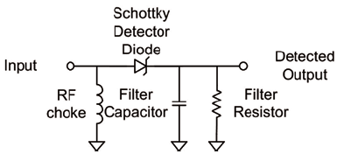
Schottky Diodes
Si and GaAs Frequency Mixing Detection

Slide 35
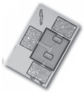


GaAs Flip Chip Schottky Diodes
Features
Available As:
Single Junction
Series Tees
Reverse Series Tees
Antiparallel Pairs
Unconnected Pairs
Low Series Resistance
Low Junction Capacitance
Applications
Mixer and Detector Applications

Slide 36
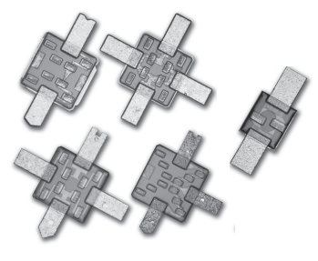

GaAs Beamlead Schottky Diodes
Features
Single Barrier Height
Frequency Range: DC – 40 GHz
Available as
Single Junction
2-, 4- and 6-Junction Series Tees
Antiparallel Pairs
4-, 8- and 12-Junction Ring Quad
Low Series Resistance
Low Junction Capacitance
Applications
Mixer and Detector Applications

Slide 37
HMICTM Discrete Schottky Diodes
Features
Surmount Single-Junction Si Schottky diodes
Low, Medium and High Barrier Heights Available
Frequency Range: DC – 30 GHz
Very Low Series Resistance
Very Low Junction Capacitance
Solderable – No Wire Bonds Required
Applications
Mixers and Detectors
Receiver Protector Limiters

Slide 38
Thank You

